Slide 1
WELCOME!

Slide 2
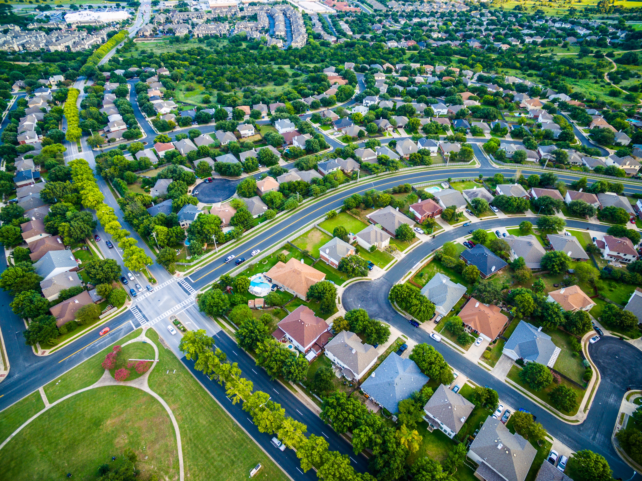
Infrastructure Access Loan
LIVE STREAM LAUNCH EVENT
Elmer Moore, Jr.
CEO & Executive Director
Notes:
ELMER

Slide 3
NEW PROGRAM INFORMATION!

Slide 4
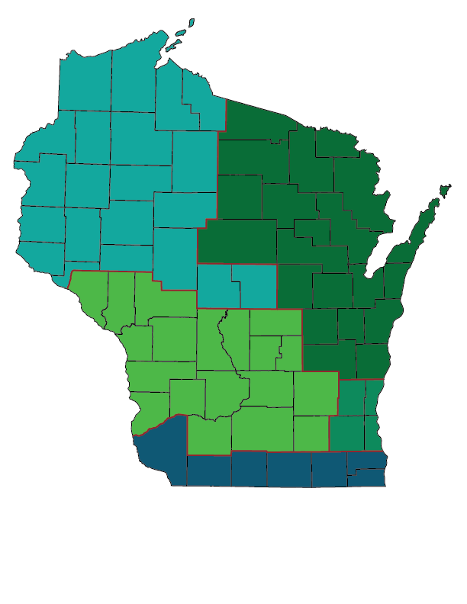
COMMUNITY & ECONOMIC DEVELOPMENT TEAM
Mai Xiong - Northwest
Jon Searles - Northeast
Rebecca Giroux - Central
Jeff Towne - South
Maria Watts - Southeast
Notes:
Reach out to us with questions you have about possible projects or with assistance submitting your application for funding.

Slide 5
OVERVIEW
Infrastructure Access Loan
Notes:
JON
-Infrastructure Access provides funding for installing, replacing or improving public infrastructure that supports workforce housing or senior housing.
-What’s unique here is that if WHEDA provides a loan to a developer, we can also award a loan to municipalities having jurisdiction over the project.
-I’ll explain in just a little bit how this works.
TEXT FROM SLIDE:
Allows a developer and a governmental unit to apply for a loan to help cover the cost of installing, replacing, upgrading or improving public infrastructure related to workforce housing or senior housing.
Financing will be provided by WHEDA through a revolving loan fund that is subordinate to other funding sources.
Purpose: covers housing infrastructure costs.
Eligible borrowers: developers and municipalities.

Slide 6
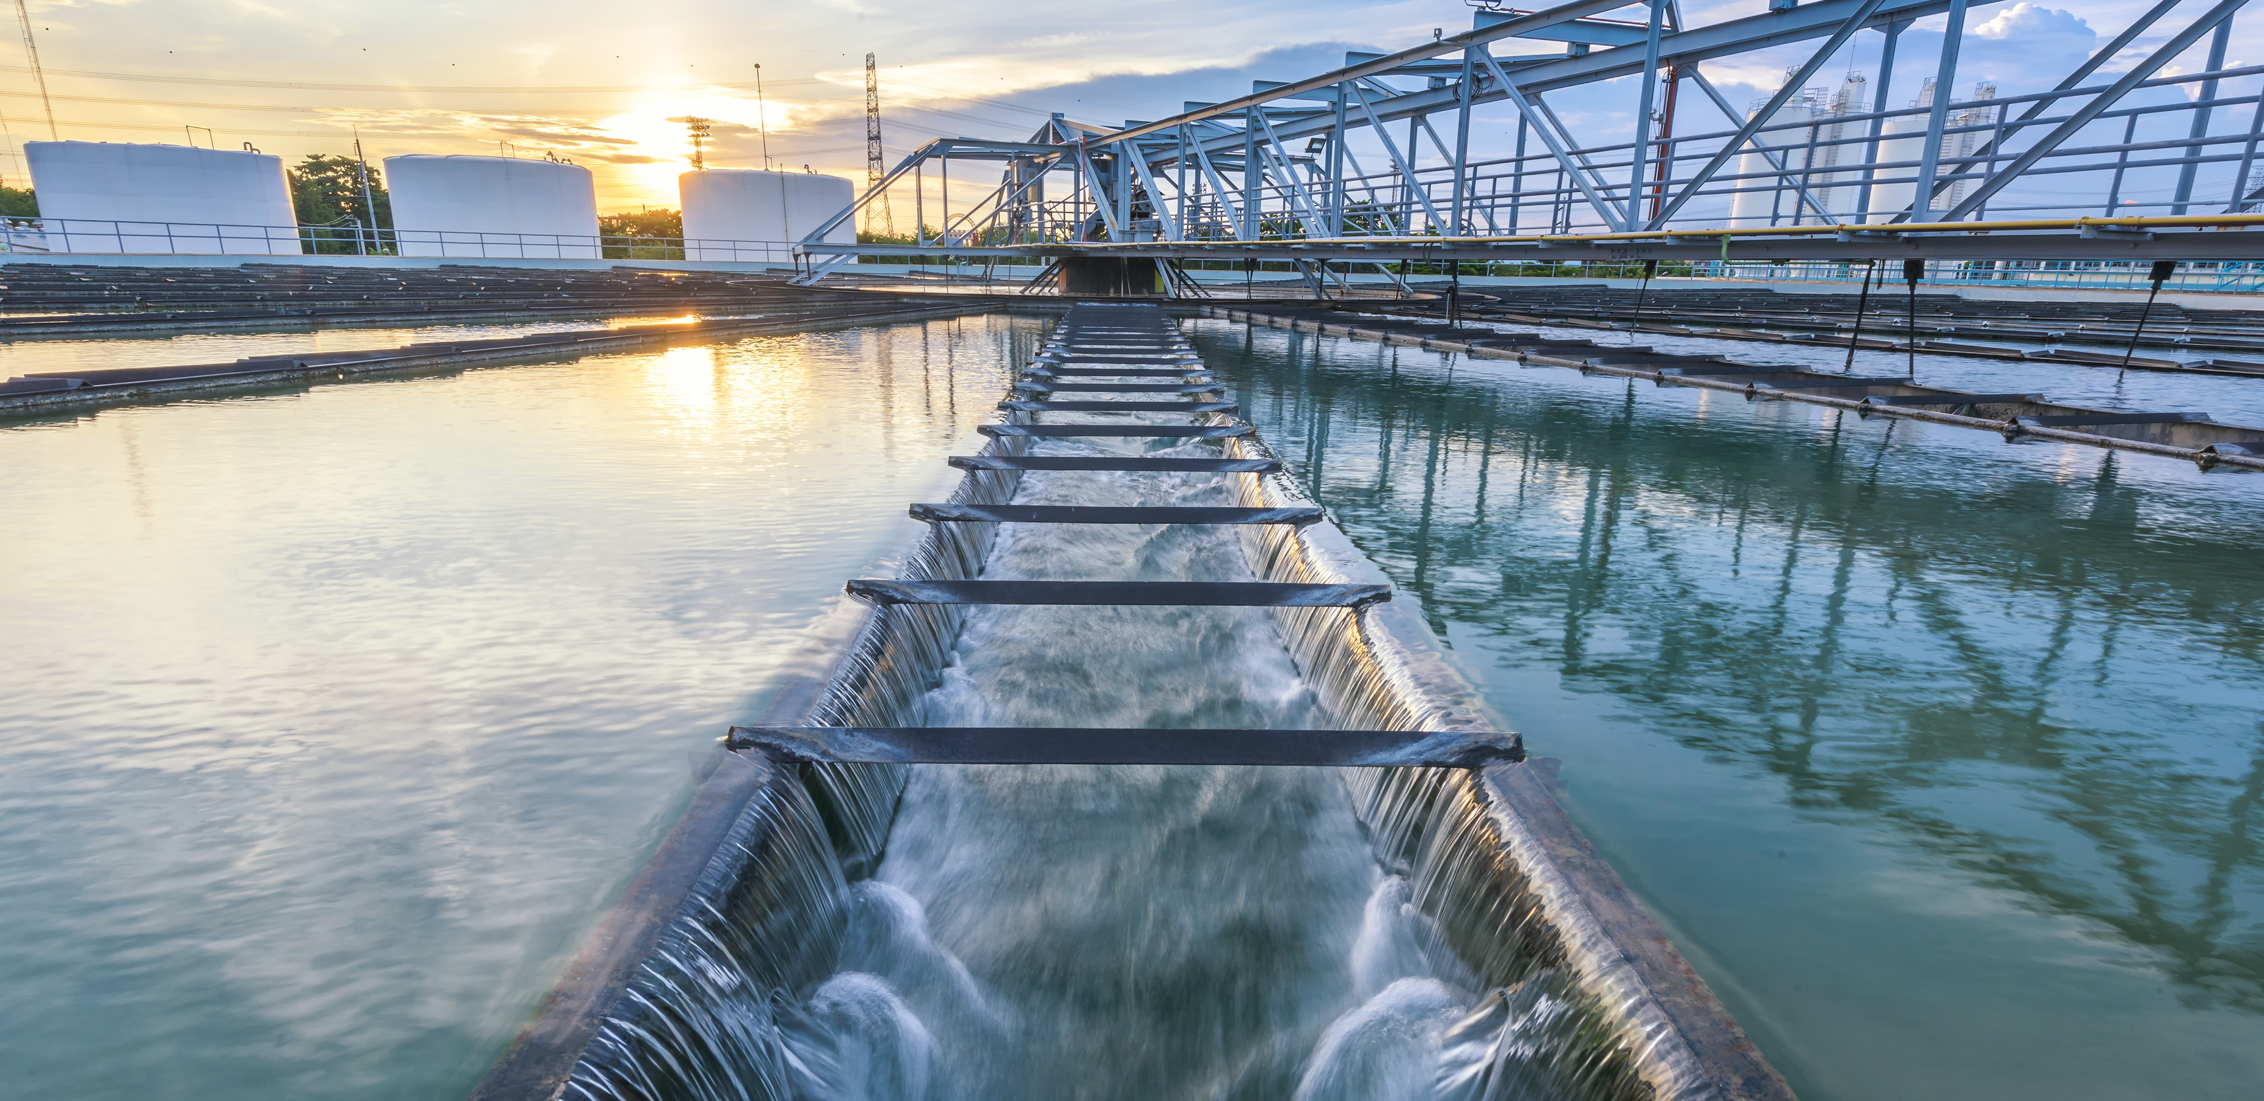
INFRASTRUCTURE DEFINITION
A portion of the installation, replacement, upgrade or improvement of public or private infrastructure in rural areas if transferred to public use
Notes:
JON
-You can install new, replace, upgrade or improve the bulleted things on this slide.
-You can see a lot of water systems as well as roads, sidewalks, curbs, lights and electric or gas distribution lines.
FROM SLIDE:
Housing infrastructure is that “portion of the installation, replacement, upgrade or improvement of public or private infrastructure in rural areas if transferred to public use.”
Water distribution system
Water treatment plant
Wastewater treatment plant
Sanitary sewer system
Storm sewer system
Stormwater retention pond
Lift or pump station
Street, road, alley, or bridge
Curb, gutter, or sidewalk
Traffic device
Street light
Electric or gas distribution line

Slide 7
AFFORDABILITY
Affordability requirements for homeowners and renters
Notes:
JON
-This really this defines what workforce housing means in Wisconsin.
-The affordability requirements for Infrastructure Access are identical to the other new products and are designed to truly serve the workforce, seniors and missing middle families.
-Homes can be created for owners as well as renters.
-Renters can earn up to 100% of AMI.
-Homeowners can earn up to 140% of AMI.
-All homes must be affordable for 10 years.
FROM SLIDE:
Apartments are reserved for families earning up to 100% of AMI.
For homeowners, household income cannot exceed 140% of AMI.
Homes must remain affordable for 10 years.

Slide 8
SET ASIDES
Small community set aside
Senior housing set aside
Notes:
MAI
-The set asides described on this slide are in place for at least four years.
-30% of funds are set aside for small communities.
-25% of funds are set aside for senior housing projects. Senior housing is defined as at least one person in the home being 55 years old or older.
-Now that seems young to me. To give you some context, Will Smith, Hugh Jackman, Kylie Minogue and Ziggy Marley all qualify.
-No area served by a regional planning commission can receive more than 25% of all loans.
FROM SLIDE:
$275 million total program.
30% of funds set aside for projects in communities of 10,000 or less.
25% of funds set aside for projects supporting senior housing.
One person in the home must be age 55 or older
Areas served by regional planning commissions can receive up to 25%.

Slide 9
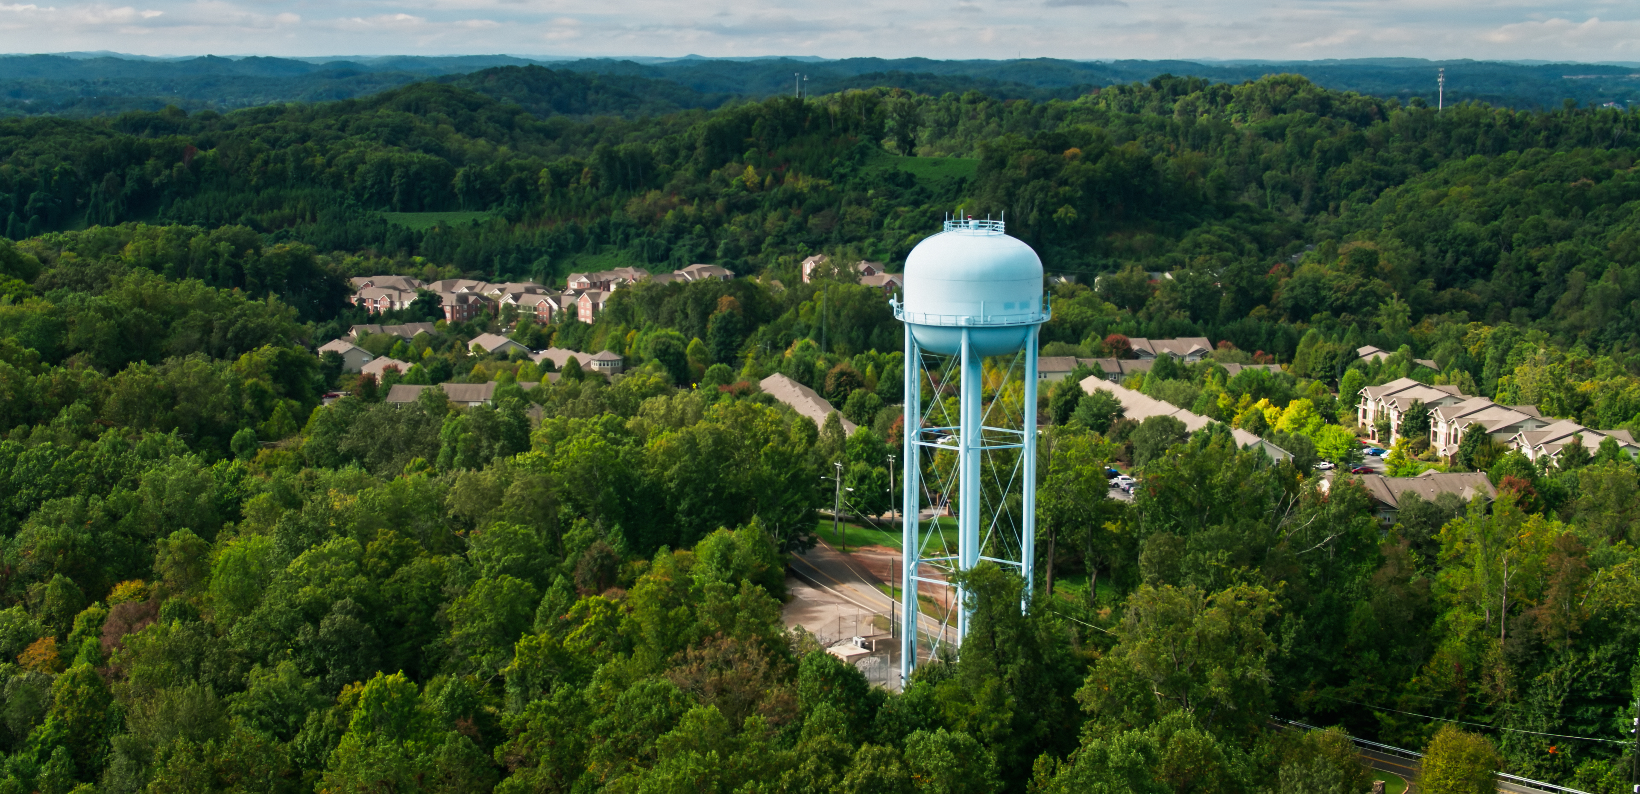
TERMS AND INTEREST RATES
3% interest rate generally
1% for projects in communities of less than 10,000 people
1% for senior housing
Notes:
MAI
-Developers can receive the lessor of the total infrastructure cost or 20% of the total development cost of the homes supported by the project.
-For municipalities, or governmental units, they can receive the lessor of the public infrastructure cost or 10% of the total development cost of the homes supported by the project.
-And, here are the rates. It’s 3% generally, but projects located in small communities of less than 10,000 people can receive a rate of 1%. And seniors housing projects can also receive 1%.
FROM SLIDE:
Developers can apply for the lessor of total infrastructure cost or 20% of the total development cost, including land, of the homes supported by the project.
Governmental units may apply for the lessor of the public infrastructure cost or 10% of the total cost of development of the homes supported by the project.
Rates:
3%
1% for small communities with fewer than 10,000 people
1% for senior housing

Slide 10
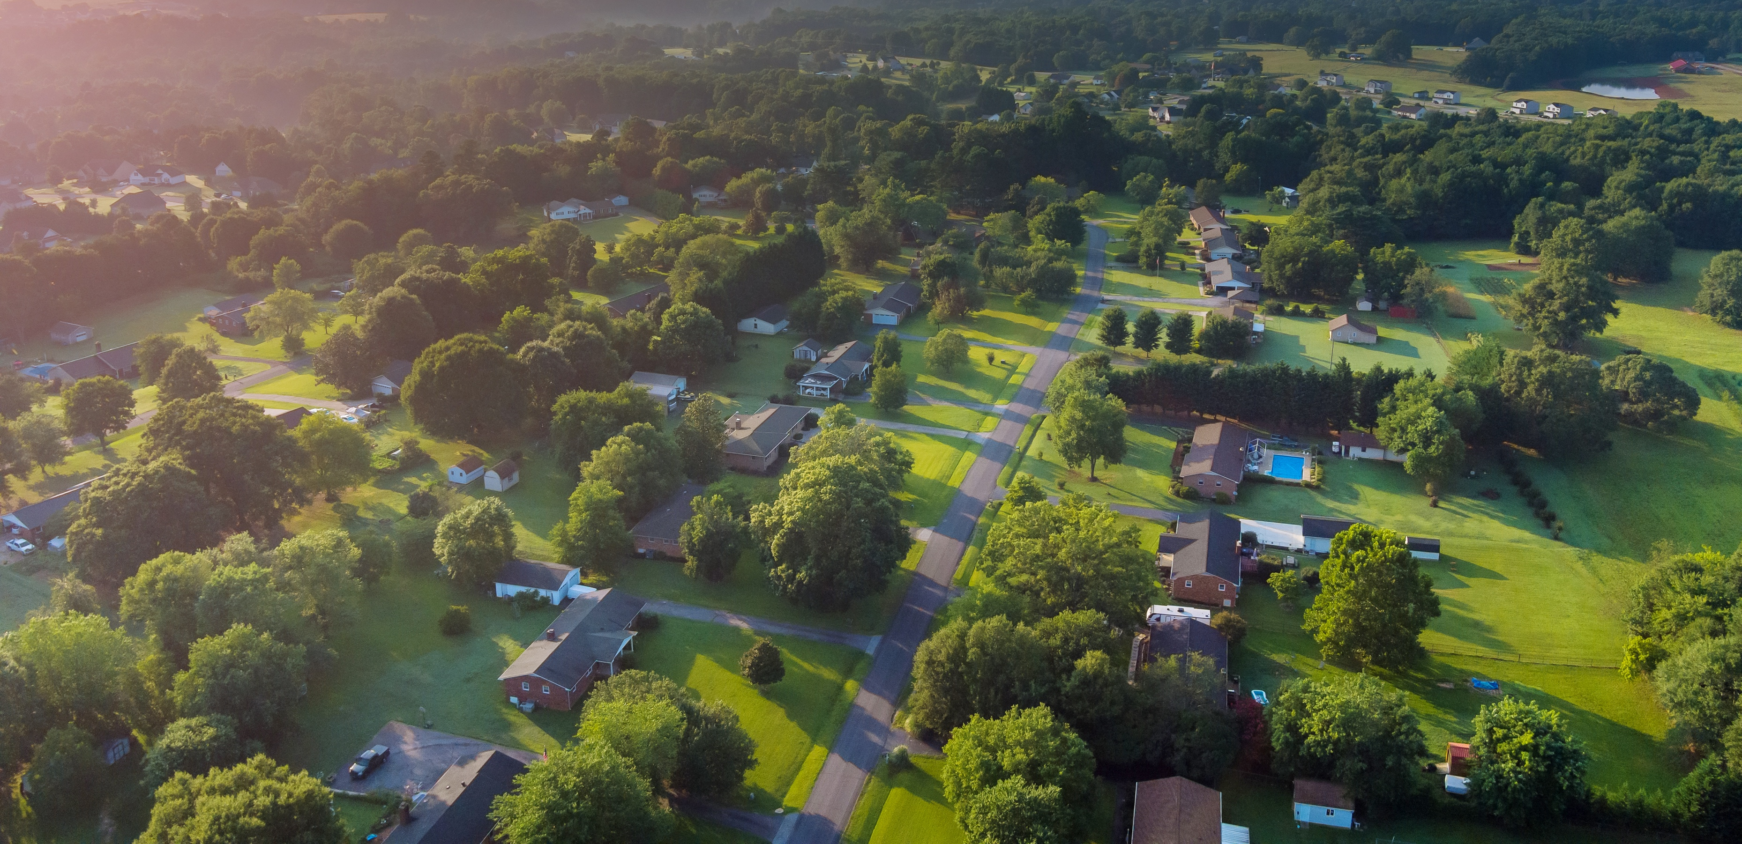
RURAL INFRASTRUCTURE ACCESS EXAMPLE
A new subdivision with detached single family homes needs streets

Slide 11
NEW SINGLE FAMILY SUBDIVISION
Notes:
MAI
-When say Total Development Cost, we’re referring to both the cost of infrastructure and housing.
-Bottom of the slide, the award can go up to but not exceed the total infrastructure cost, so that’s why you see $3 million reflected on the slide.
FROM SLIDE;
A new subdivision with detached single family homes needs streets.
New streets cost: $3 million
Total development cost: $26 million, including $500,000 for land.
Developers can apply for up to*: $3 million, which meets the infrastructure need. ($26 million - $3 million) x 20% = $4.6 million. Loan is sized to infrastructure cost.
20% of the housing portion of the total development cost exceeds infrastructure, so infrastructure cost is the target.
Government units can apply for up to: $0, since a successful developer application would satisfy the infrastructure need.
Total from two successful applications: $3 million, covering the infrastructure cost.
*Land cost is included for the developer, but not the municipality.

Slide 12
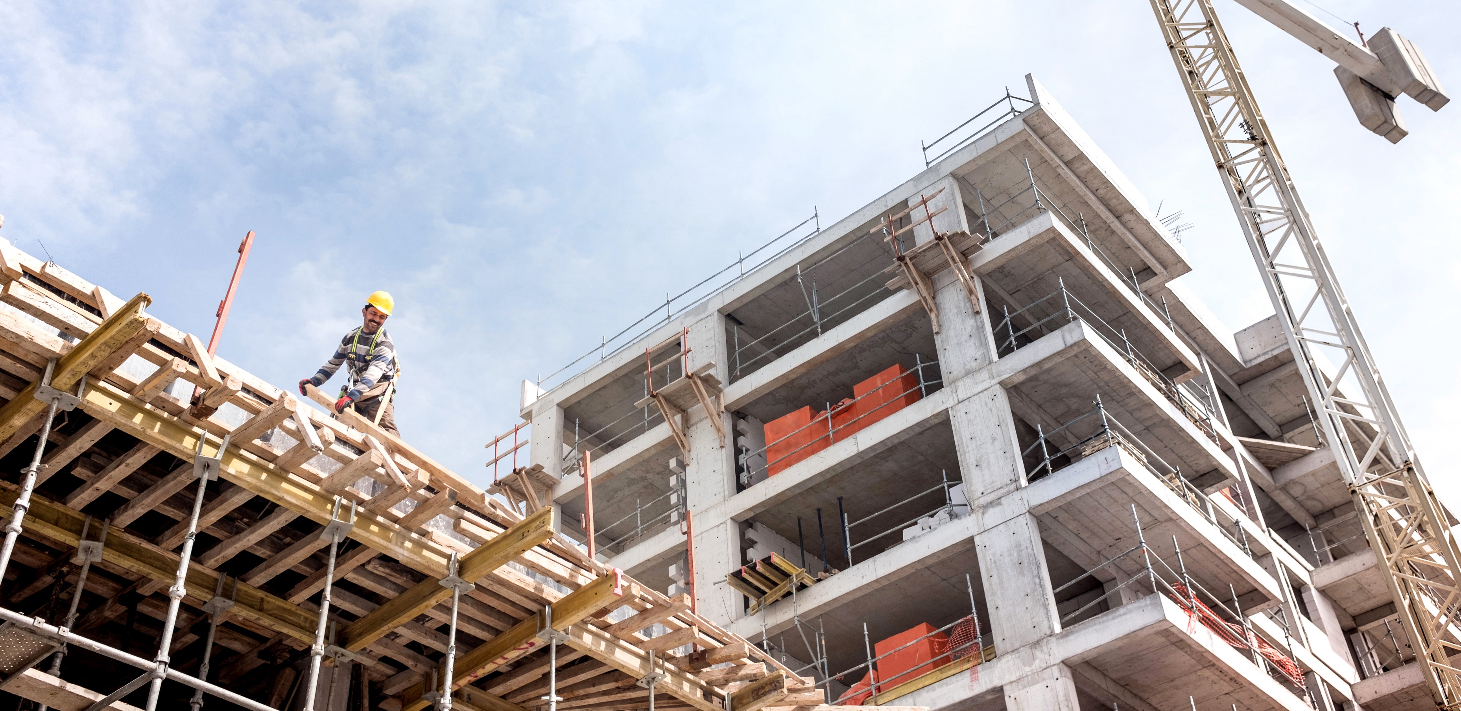
URBAN INFRASTRUCTURE ACCESS EXAMPLE
A new construction workforce housing development in a revitalizing neighborhood needs to replace a storm sewer system

Slide 13
WORKFORCE HOUSING NEW CONSTRUCTION
Notes:
MAI
-When say Total Development Cost, we’re referring to both the cost of infrastructure and housing.
-Bottom of the slide, the award can go up to but not exceed the total infrastructure cost, so that’s why you see $3 million reflected on the slide.
FROM SLIDE:
A new construction workforce housing development in a revitalizing neighborhood needs to replace a storm sewer system.
Storm sewer system cost: $4 million
Total development cost: $20 million, excluding donated land.
Developers can apply for up to*: $3.2 million, ($20 million - $4 million) x 20% = $3.2 million.
20% of the housing portion of the total development cost exceeds infrastructure, so infrastructure is the target.
Government units can apply for up to: Approx. $800,000 Developer and government unit size loans up to infrastructure cost.
Total from two successful applications: $4 million, $3.2 million + $800,000 = $4 million.
*Land cost is included for the developer, but not the municipality.

Slide 14
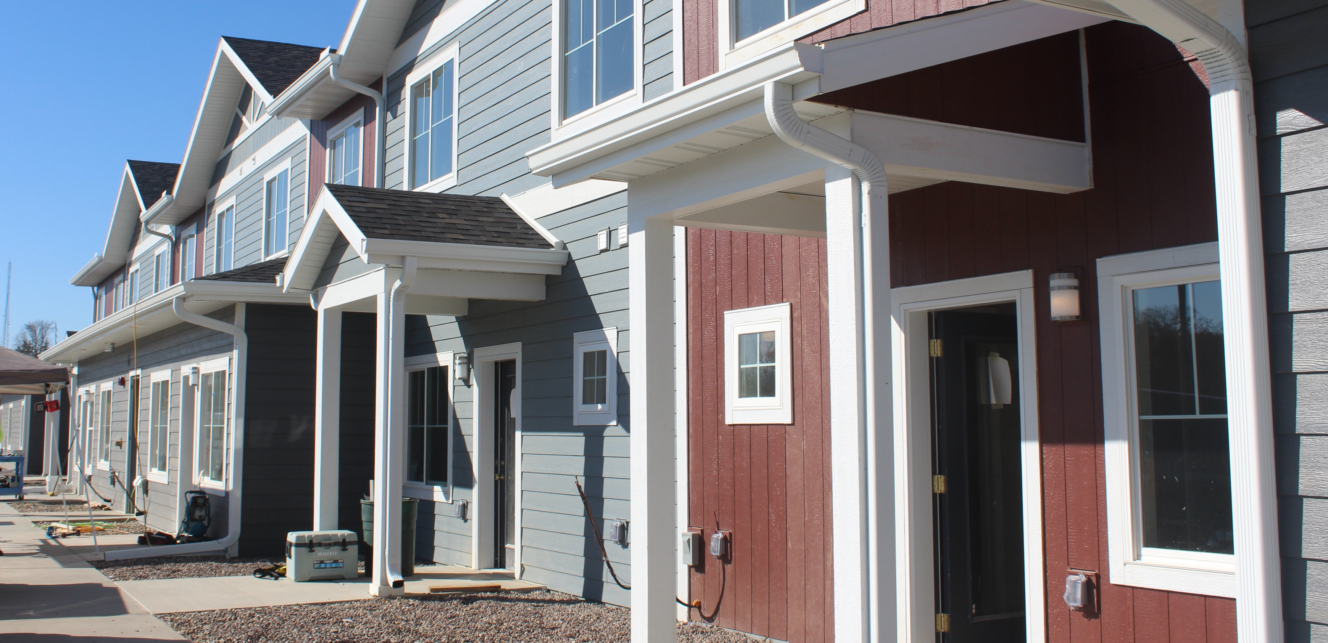
SMALL COMMUNITY INFRASTRUCTURE ACCESS EXAMPLE
A large middle-income condominium needs curbs, gutters, sidewalks and streetlights
Notes:
JON
-When say Total Development Cost, we’re referring to both the cost of infrastructure and housing.
-A small community is defined as 10,000 people or fewer.
FROM SLIDE:
A large middle-income condominium needs curbs, gutters, sidewalks and streetlights.
Infrastructure cost: $4 million
Total development cost: $22 million, including $500,000 for land
Developers can apply for up to*: $3.6 million, which is less than infrastructure costs. ($22 million - $4 million) x 20% = $3.6 million.
Government units can apply for up to: Approx. $400,000, which is less than infrastructure costs. ($22 million - $4 million - $500,000) x 10% = $1,750,000. Developer and government unit size loans up to infrastructure cost.
Total from two successful applications: $4 million; $3.6 million + $400,000 = $4 million.
*Land cost is included for the developer, but not the municipality.

Slide 15
MIDDLE-INCOME CONDOMINIUM
Notes:
JON
-When say Total Development Cost, we’re referring to both the cost of infrastructure and housing.
-A small community is defined as 10,000 people or fewer.
FROM SLIDE:
A large middle-income condominium needs curbs, gutters, sidewalks and streetlights.
Infrastructure cost: $4 million
Total development cost: $22 million, including $500,000 for land
Developers can apply for up to*: $3.6 million, which is less than infrastructure costs. ($22 million - $4 million) x 20% = $3.6 million.
Government units can apply for up to: Approx. $400,000, which is less than infrastructure costs. ($22 million - $4 million - $500,000) x 10% = $1,750,000. Developer and government unit size loans up to infrastructure cost.
Total from two successful applications: $4 million; $3.6 million + $400,000 = $4 million.
*Land cost is included for the developer, but not the municipality.

Slide 16
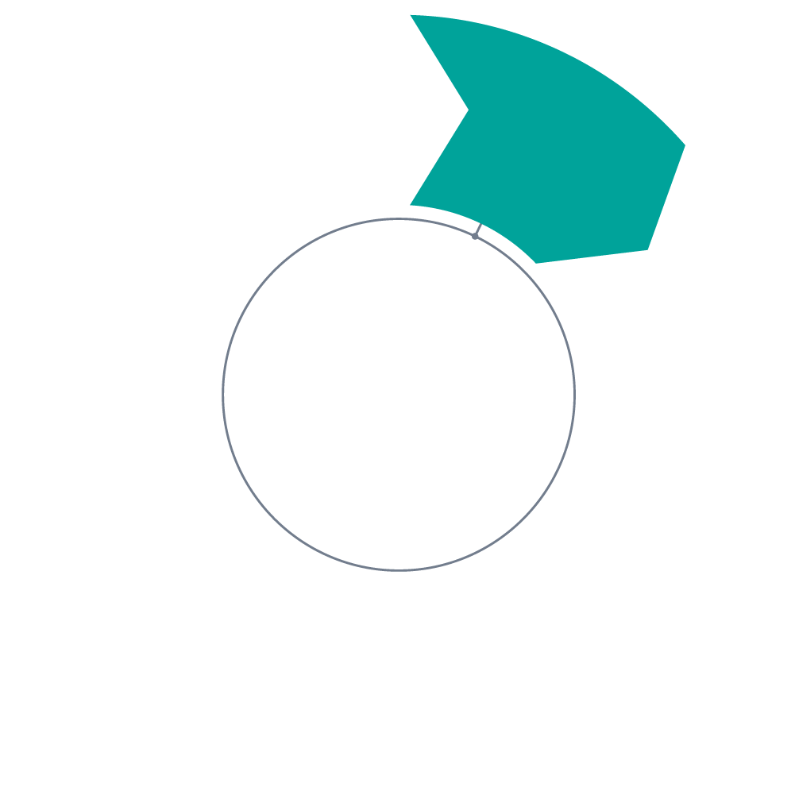
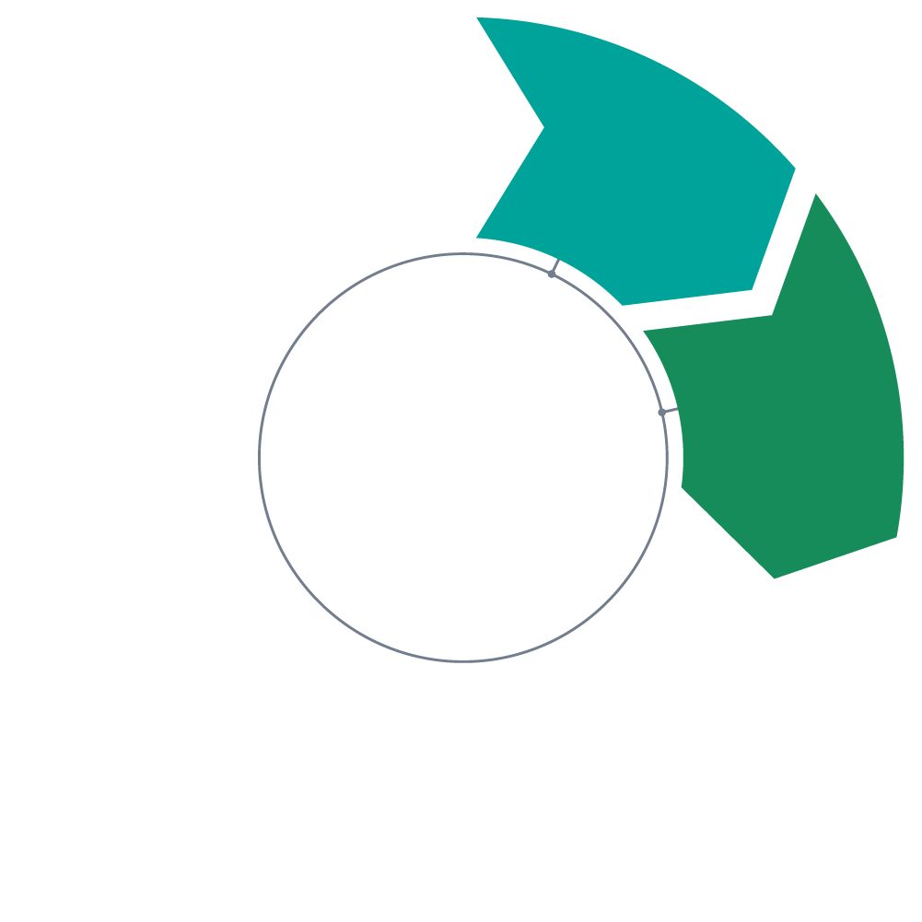
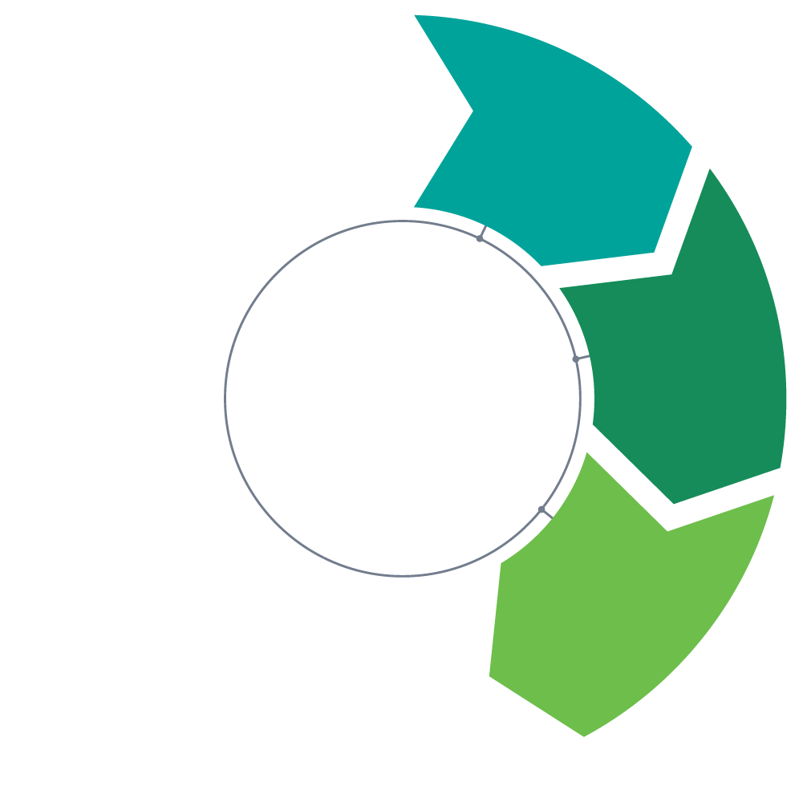
HOW IT WORKS
4
3
7
2
1
6
5
Developer selects site
Municipality and developer identify infrastructure need
Municipalities applies either concurrently or in a later round
WHEDA reviews applications and announces awards
Municipality and developer work on application; e.g. Cost Reduction Analysis
Developer applies
Repeat
Notes:
JON
-The application process for Infrastructure Access is different from others, so I’ll go through it step by step.
-The main idea Municipalities and developers should coordinate closely to ensure project success.
The developer will select the site, ideally with support from the village.
The municipality and developer identify an infrastructure need from that list shared a bit earlier and prioritize what’s needed for funding.
Most likely, the developer and municipality will work together on the application. In particular, the Cost Reduction Analysis.
The developer applies.
And then the municipality applies either concurrently or in a later round.
WHEDA will review the applications for completeness and to ensure requirements are met. We’ll announce the awards through all of our channels.
The process repeats. We intend to do a semiannual application process for Infrastructure Access and all other products.

Slide 17
YOU’VE GOT QUESTIONS?
WE’VE GOT ANSWERS.

Slide 18
NEW PROGRAM INFORMATION!

Slide 19
Let’s get this application cycle started!

Slide 20
APPLICATION LAUNCH

Slide 22
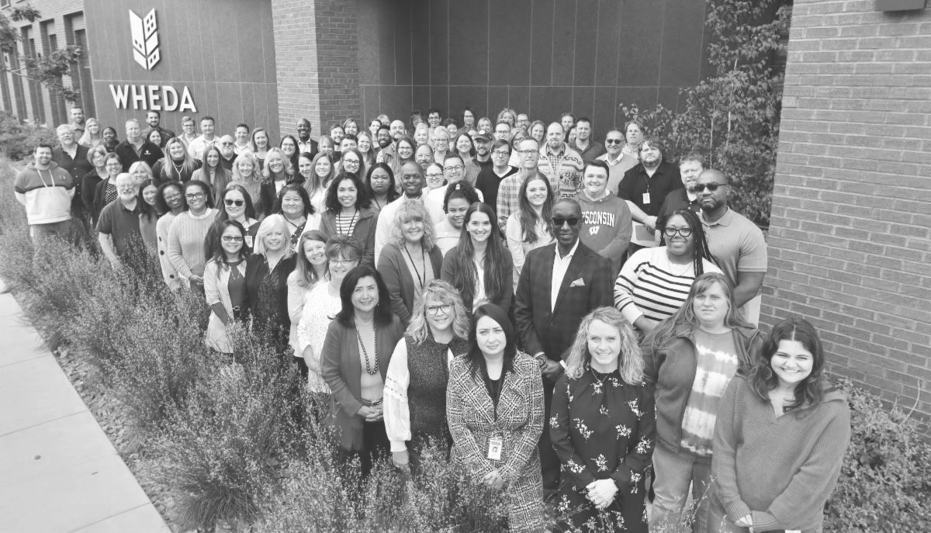
THANK YOU!
Notes:
-We’ll open it up to questions. We also welcome any comments from anyone.

